Slide 1
Resp Org Profile (ROP) (Service Maintenance folder)
A. URC - User Control Tab
B. ORC – Resp Org Control Tab
C. ORG – Resp Org Information Tab
SMS/800 ® is a registered trademark of SMS/800, Inc.
Notes:
The ROP screen is where Users would enter their Email Addresses to get messages from SMS/800.
There are 3 Tabs on the Resp Org Profile (ROP) screen.
(Click)
The URC – User Control Tab
(Click)
The ORC – Resp Org Control Tab
(Click)
The ORG – Resp Org Information Tab

Slide 2
URC (1ST tab) - User Control
To designate Email address(es) where Users can receive SMS/800 messages sent only to the individual Logon ID(s).
Email@email.com
Default info for NUS
Notes:
The first Tab of the ROP is the URC (User Control tab)
(Click) (Click)
To receive messages to the user id email from SMS800, place a check mark by “User Primary Email Address” and enter the email address in the field. Then Update.
(Click) (Click) (Click)
(Click)
Also, At the bottom of this page is the Default info for the NUS.

Slide 3
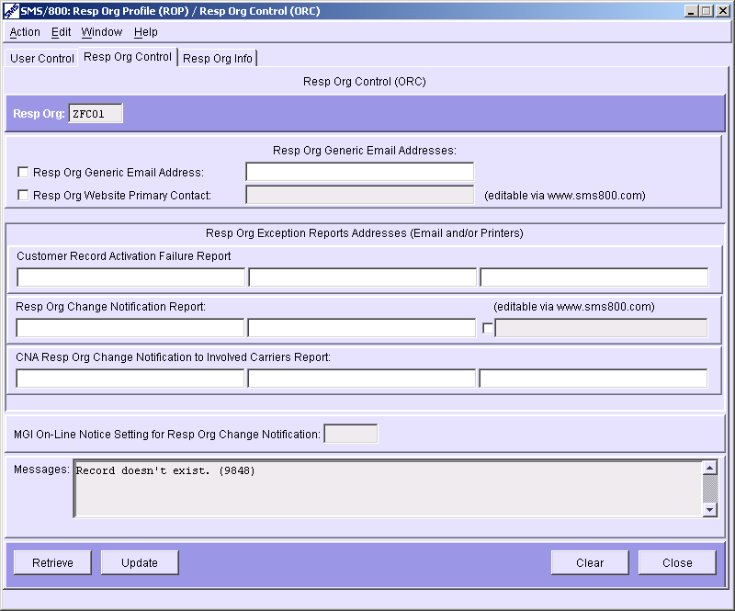
ORC (2ND tab) - Resp Org Control
To designate Email address(es) where users can read SMS/800 messages sent to users under their Resp Org ID.
ORC 2nd TAB
a. Generic -(Bulletin Board message) (FAILED-status)
b. Activation Failures (i.e. Sending)
RO Change notification
Carrier RO change notification
Notes:
The 2nd tab of the ROP is the ORC tab.
(Click)
Here a company would enter email addresses for their Resp Org. Notifications that effect the company will be sent to emails on this tab.
(Click)
The first email is the Generic email box. When a Resp Org needs to be notified for a specific reason (i.e. when a CR goes into a Failed status instead of Active)
(Click) (Click)
There are up to 3 email entries that can get notifications when a record gets stuck in sending.
(Click) (Click)
There are up to 3 email entries that could receive notifications when a RO change occurs on a CR in the RO id on this page.
(Click)
If you are a carrier, you can be notified when the RO id is changed on a CR for which you are the Carrier.

Slide 4
ORG (3rd tab) - Resp Org Info
The SMS/800 Resp Org Information(ORG) window is used by Resp Org Users to view and print Resp Org information for any Resp Org (or) Dial Number in SMS/800.
ORG 3rd TAB
Notes:
The 3rd tab of the ROP is the ORG (Resp Org Info).
(Click)
The SMS/800 Resp Org Information(ORG) window is used by Resp Org Users to view and print Resp Org information for any Resp Org (or) Dial Number in SMS/800
(Click)

Slide 5
Access ORG Window from CAD Window
1. Retrieve the Customer Record from the CAD Window.
2. Right-click on the Resp Org field and click the “go to ORG window” option.
3. The ORG Window will open, populated with the Resp Org’s information.
Right click
Notes:
A quick way to access the ORG from the CAD screen is to right click on the RO id field of the CAD.
(Click)
(Click)
First:
1. Retrieve the Customer Record from the CAD Window.
2. Right-click on the Resp Org field and click the “go to ORG window” option.
3. The ORG Window will open, populated with the Resp Org’s information.
(Click)

Slide 6
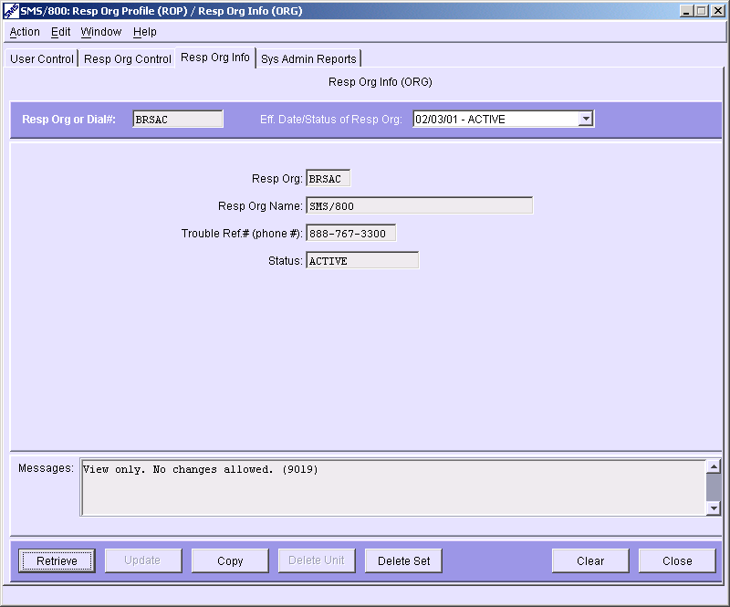
ORG for RO-ID
To look up Resp Org Information for a RO ID.
a. Type RO ID in Resp Org field (i.e. BRSAC)
b. Press Retrieve
c. View RO information
Help Desk Only
Notes:
(Click) (Click)
To look up Resp Org Information for a RO ID.
(Click) (Click)
a. Type RO ID in Resp Org field (i.e. BRSAC)
(Click) (Click)
b. Press Retrieve
(Click)
View the displayed RO information

Slide 7

ORG for Dial#
To look up Resp Org Information for a Dial#.
a. Type Dial# in Dial# field (i.e. 800flowers)
b. Press Retrieve
c. View Resulting information
Help Desk Only
Notes:
To look up Resp Org Information for a Dial#.
(Click) (Click)
a. Type Dial# in Dial# field (i.e. 800flowers)
(Click) (Click)
b. Press Retrieve
(Click) (Click)
View the information
(Click) (Click)

Slide 8
ROP - Review
URC - User Control Tab
ORC – Resp Org Control Tab
ORG – Resp Org Information Tab
Written Exercise ROP #9
Hands-On Exercises ROP (9A)
Notes:
Please complete the Written and Hands On exercises.

